Slide 1
Parallel Algorithms for Dense Matrices
CS121 Parallel Computing
Fall 2021

Slide 2
Dense matrices
Dense matrices are ones where most elements are nonzero.
Dense matrices are used in many optimization problems, and physics and chemistry based simulations.
Many dense matrix operations are compute bound. This, plus their highly regular structure, allows dense matrix operations to be highly optimized.
High performance parallel implementations provided by LAPACK, ScaLAPACK, HPL, etc.
We’ll look at algorithms for matrix-vector multiplication, matrix-matrix multiplication and equation solving (Gaussian elimination).

Slide 3
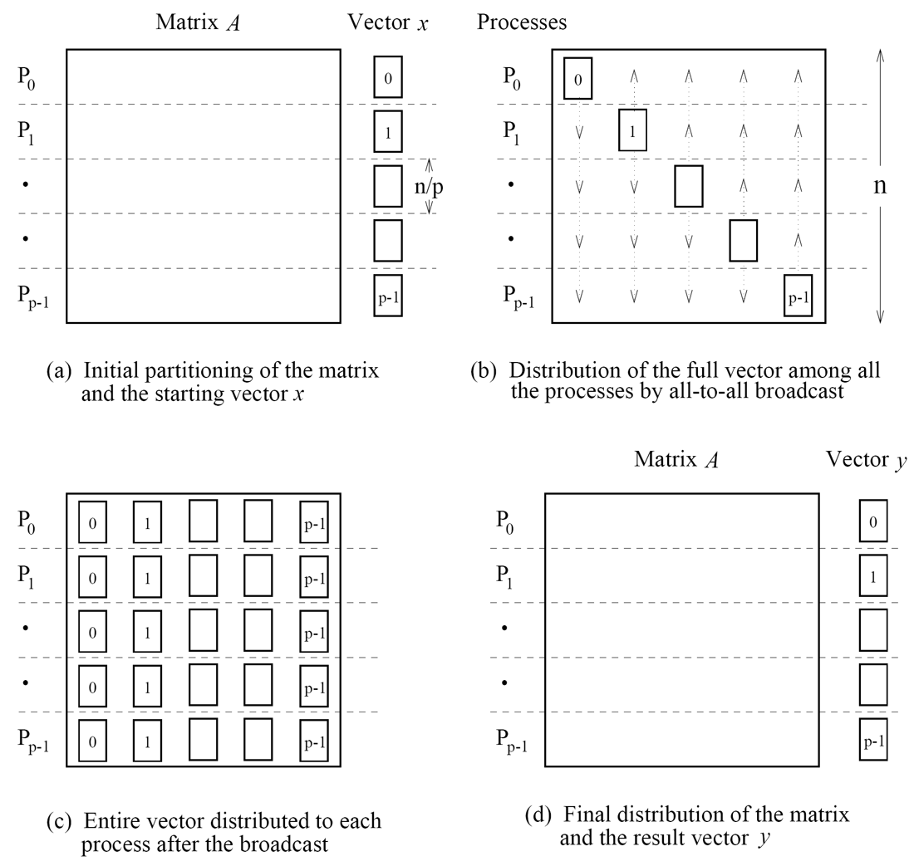
1D matrix-vector multiplication
Consider an n x n matrix A and an n x 1 vector x partitioned across p ≤ n processors.
Initially each process stores n/p rows of A and n/p values of x.
Each process needs the entire vector to multiply by its rows.
In step (b), do all-to-all broadcast of the processors’ vector segments.
Each process multiplies the vector by its rows.
Each process ends up with n/p values of the output.
Source: Introduction to Parallel Computing, Grama et al

Slide 4
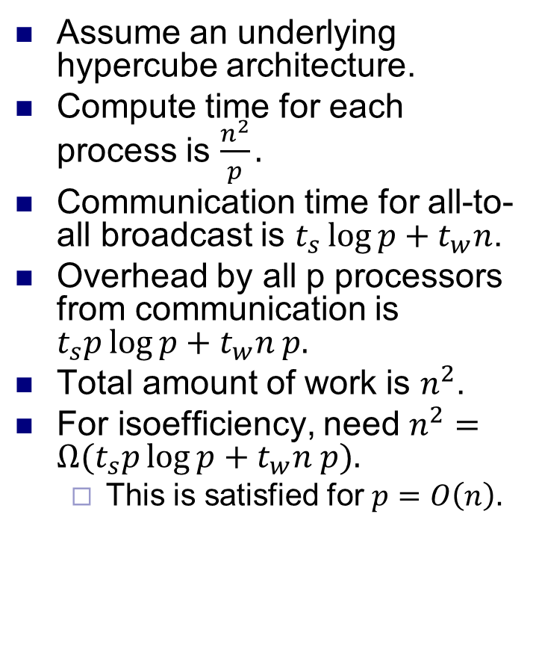
1D matrix-vector multiplication
Assume an underlying hypercube architecture.
Compute time for each process is $\frac{n^{2}}{p}.$
Communication time for all-to-all broadcast is $t_{s}\log{p+t_{w}n}$.
Overhead by all p processors from communication is $t_{s}p\log{p+t_{w}n p.}$
Total amount of work is $n^{2}$.
For isoefficiency, need $n^{2}=Ω(t_{s}p\log{p+t_{w}n p).}$
This is satisfied for $p=O\left(n\right).$

Slide 5
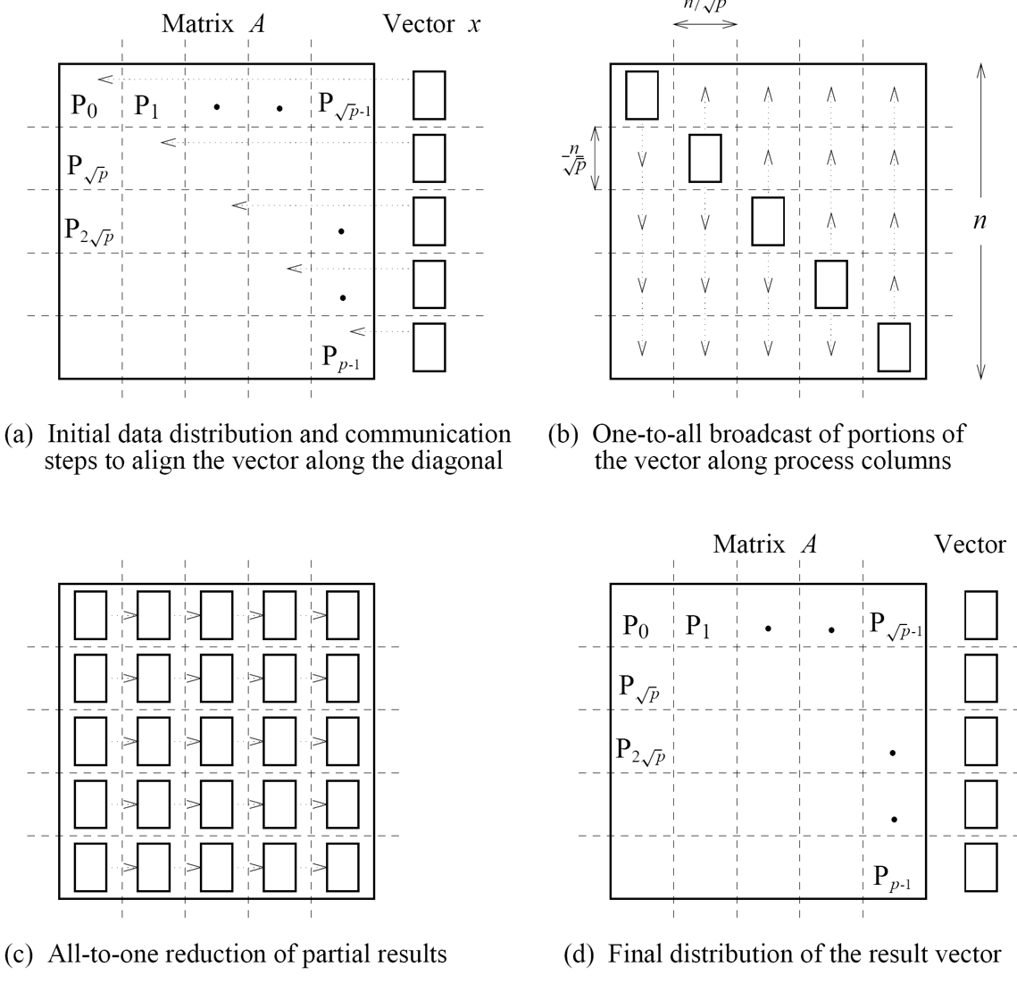
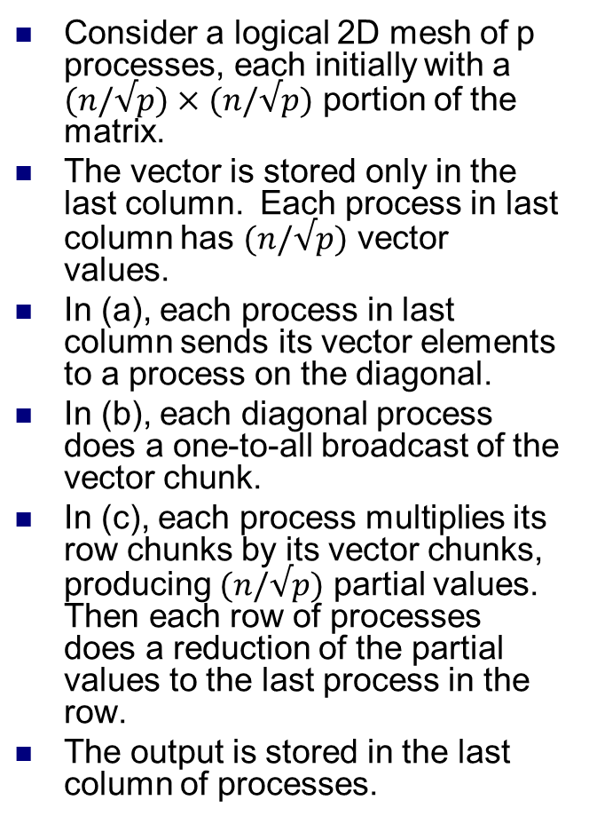
2D matrix-vector multiplication
Consider a logical 2D mesh of p processes, each initially with a $(n/√p)×$ $(n/√p)$ portion of the matrix.
The vector is stored only in the last column. Each process in last column has $(n/√p)$ vector values.
In (a), each process in last column sends its vector elements to a process on the diagonal.
In (b), each diagonal process does a one-to-all broadcast of the vector chunk.
In (c), each process multiplies its row chunks by its vector chunks, producing $(n/√p)$ partial values. Then each row of processes does a reduction of the partial values to the last process in the row.
The output is stored in the last column of processes.

Slide 6
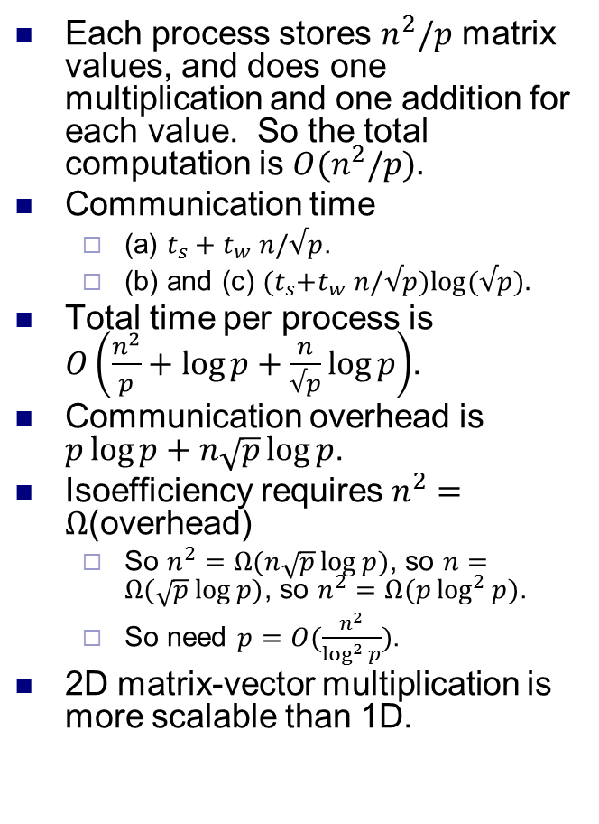
2D matrix-vector multiplication
Each process stores $n^{2}/p$ matrix values, and does one multiplication and one addition for each value. So the total computation is $O(n^{2}/p).$
Communication time
(a) $t_{s}+t_{w}$ $n/√p$.
(b) and (c) ${(t}_{s}+t_{w}$ $n/√p)log⁡(√p).$
Total time per process is $O\left(\frac{n^{2}}{p}+\log{p+\frac{n}{√p}\log{p}}\right)$.
Communication overhead is $p\log{p+n\sqrt{p}\log{p}}$.
Isoefficiency requires $n^{2}=Ω$(overhead)
So $n^{2}=Ω(n\sqrt{p}\log{p)}$, so $n=Ω(\sqrt{p}\log{p)}$, so $n^{2}=Ω(p\log^{2}{p})$.
So need $p=O(\frac{n^{2}}{\log^{2}{p}})$.
2D matrix-vector multiplication is more scalable than 1D.

Slide 7
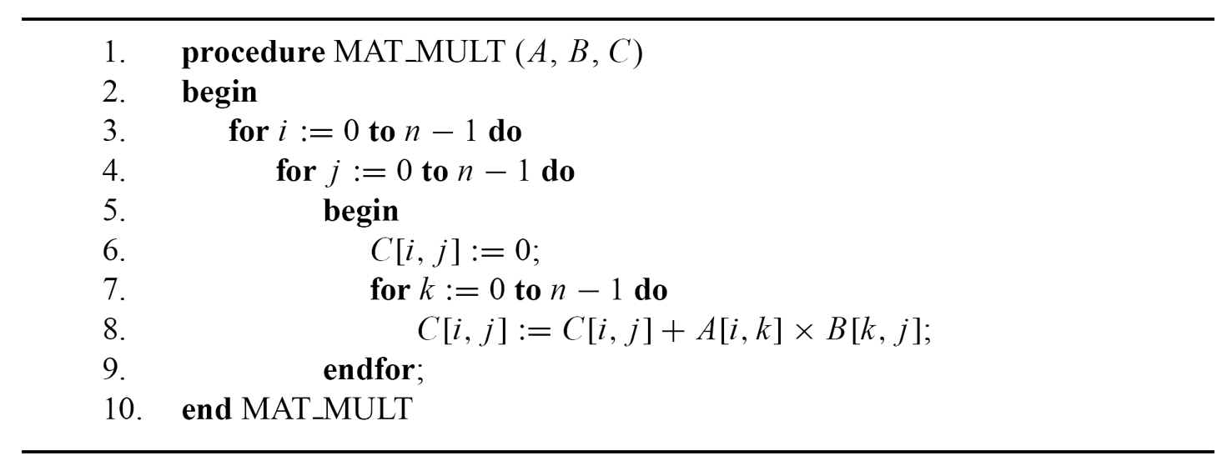
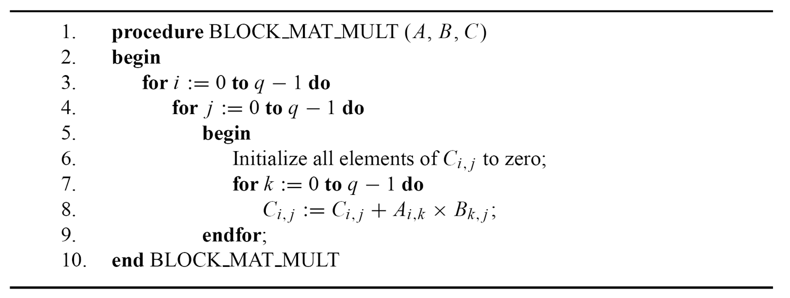
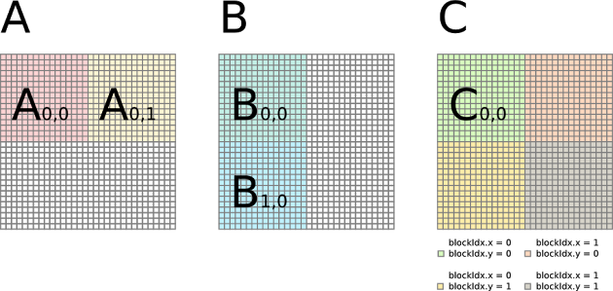
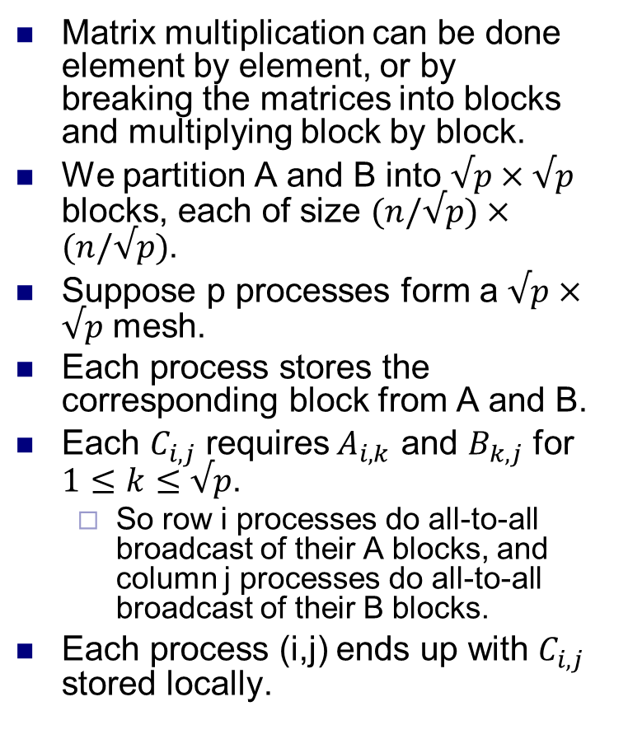
Matrix-matrix multiplication
Matrix multiplication can be done element by element, or by breaking the matrices into blocks and multiplying block by block.
We partition A and B into $√p×√p$ blocks, each of size $(n/√p)×$ $(n/√p)$.
Suppose p processes form a $√p×√p$ mesh.
Each process stores the corresponding block from A and B.
Each $C_{i,j}$ requires$A_{i,k}$ and $B_{k,j}$ for $1≤k≤√p$.
So row i processes do all-to-all broadcast of their A blocks, and column j processes do all-to-all broadcast of their B blocks.
Each process (i,j) ends up with $C_{i,j}$ stored locally.

Slide 8
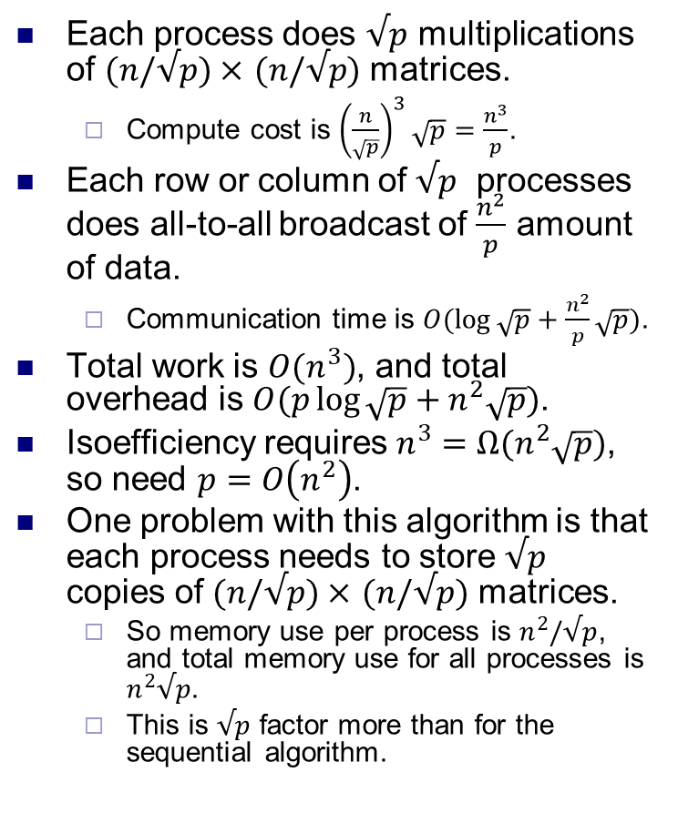
Matrix-matrix multiplication
Each process does $√p$ multiplications of $(n/√p)×$ $(n/√p)$ matrices.
Compute cost is ${\left(\frac{n}{\sqrt{p}}\right)}^{3}\sqrt{p}=\frac{n^{3}}{p}$.
Each row or column of $√p$ processes does all-to-all broadcast of $\frac{n^{2}}{p}$ amount of data.
Communication time is $O(\log{\sqrt{p}}+\frac{n^{2}}{p}\sqrt{p})$.
Total work is $O(n^{3})$, and total overhead is $O(p\log{\sqrt{p}}+n^{2}\sqrt{p})$.
Isoefficiency requires $n^{3}=Ω(n^{2}\sqrt{p})$, so need $p=O\left(n^{2}\right)$.
One problem with this algorithm is that each process needs to store $√p$ copies of $(n/√p)×$ $(n/√p)$ matrices.
So memory use per process is $n^{2}/√p$, and total memory use for all processes is $n^{2}√p$.
This is $√p$ factor more than for the sequential algorithm.

Slide 9
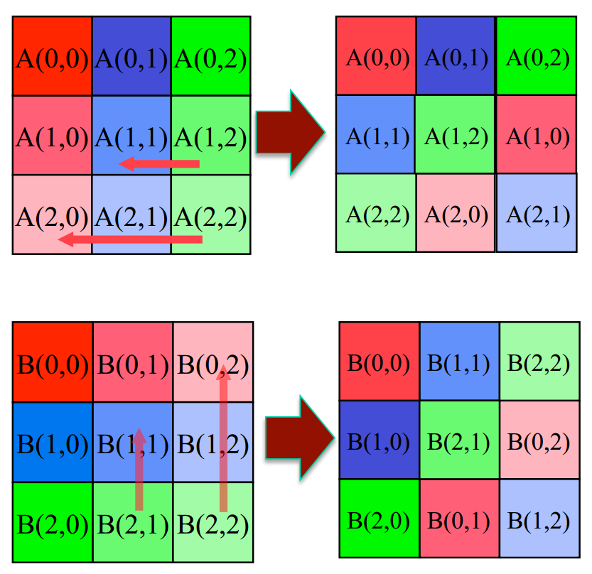
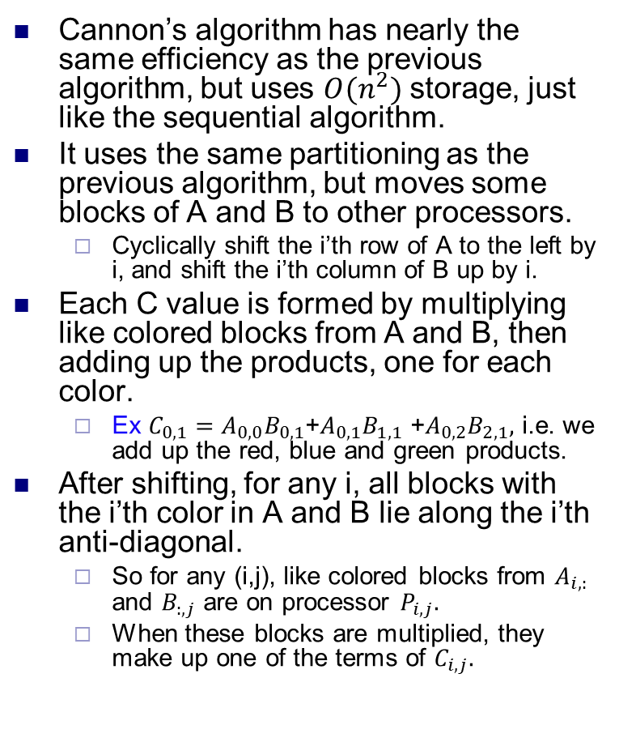
Cannon’s matrix-matrix multiplication
Cannon’s algorithm has nearly the same efficiency as the previous algorithm, but uses $O(n^{2})$ storage, just like the sequential algorithm.
It uses the same partitioning as the previous algorithm, but moves some blocks of A and B to other processors.
Cyclically shift the i’th row of A to the left by i, and shift the i’th column of B up by i.
Each C value is formed by multiplying like colored blocks from A and B, then adding up the products, one for each color.
Ex $C_{0,1}=A_{0,0}B_{0,1}$+$A_{0,1}B_{1,1}$ +$A_{0,2}B_{2,1},$ i.e. we add up the red, blue and green products.
After shifting, for any i, all blocks with the i’th color in A and B lie along the i’th anti-diagonal.
So for any (i,j), like colored blocks from $A_{i,:}$ and $B_{:,j}$ are on processor $P_{i,j}.$
When these blocks are multiplied, they make up one of the terms of $C_{i,j}.$
Source: http://cseweb.ucsd.edu/classes/fa12/cse260-b/Lectures

Slide 10
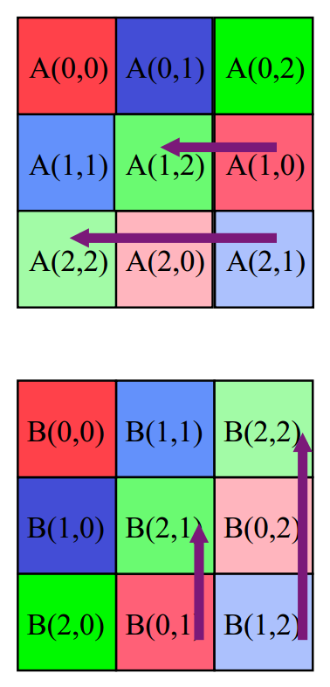
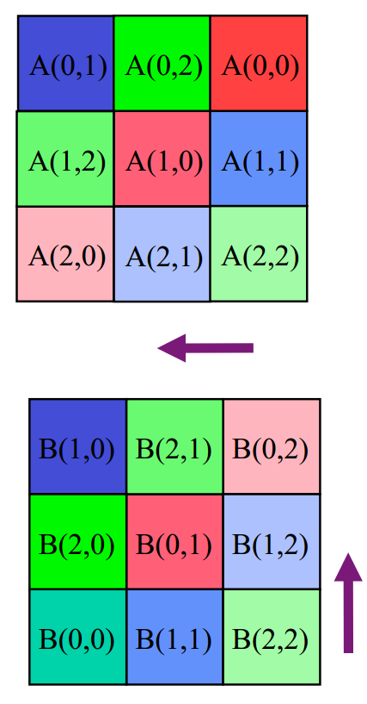
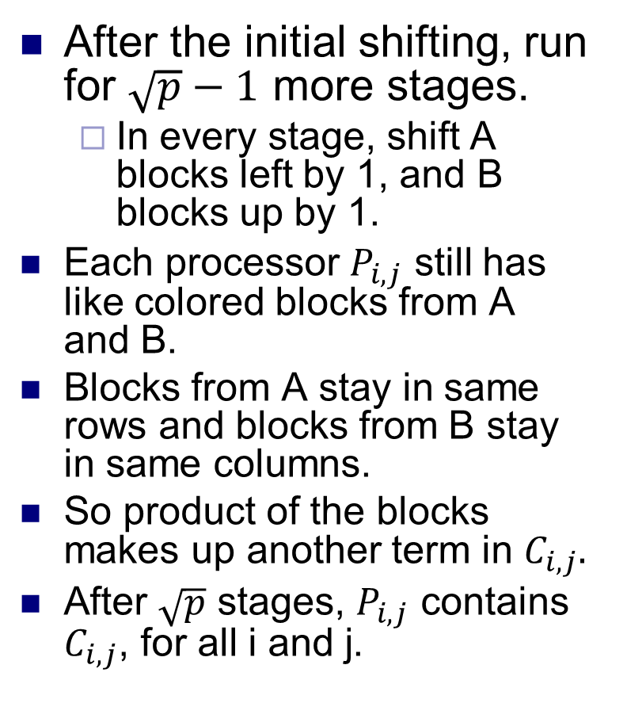
Cannon’s matrix-matrix multiplication
After the initial shifting, run for $\sqrt{p}−1$ more stages.
In every stage, shift A blocks left by 1, and B blocks up by 1.
Each processor $P_{i,j}$ still has like colored blocks from A and B.
Blocks from A stay in same rows and blocks from B stay in same columns.
So product of the blocks makes up another term in $C_{i,j}.$
After $\sqrt{p}$ stages, $P_{i,j}$ contains $C_{i,j}$, for all i and j.
Step 0
Step 1

Slide 11
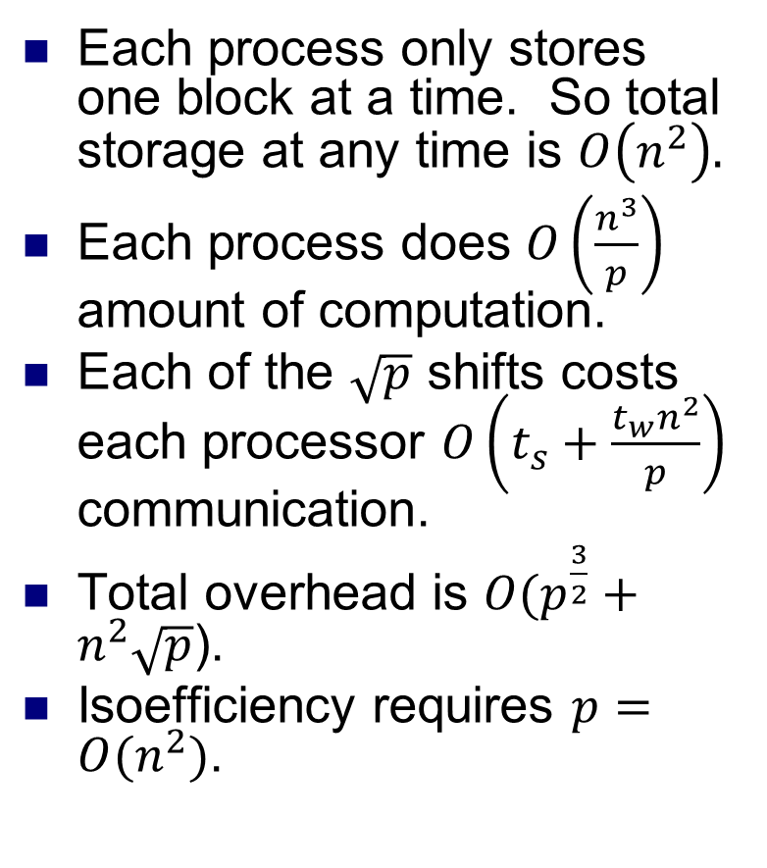
Cannon’s matrix-matrix multiplication
Each process only stores one block at a time. So total storage at any time is $O\left(n^{2}\right).$
Each process does $O\left(\frac{n^{3}}{p}\right)$ amount of computation.
Each of the $\sqrt{p}$ shifts costs each processor $O\left(t_{s}+\frac{t_{w}n^{2}}{p}\right)$ communication.
Total overhead is $O(p^{\frac{3}{2}}+n^{2}\sqrt{p}$).
Isoefficiency requires $p=O(n^{2})$.
Step 0
Step 1

Slide 12
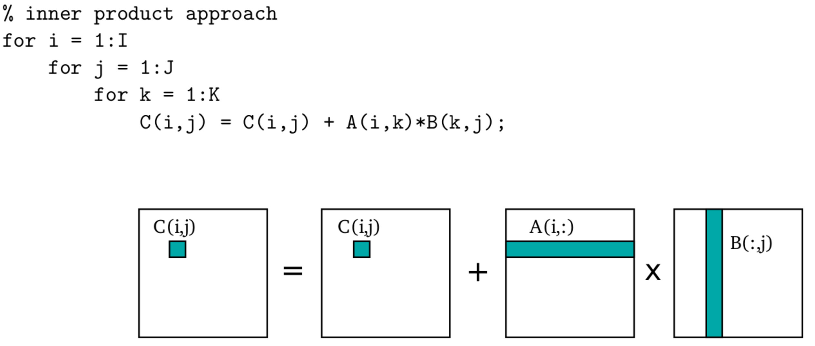
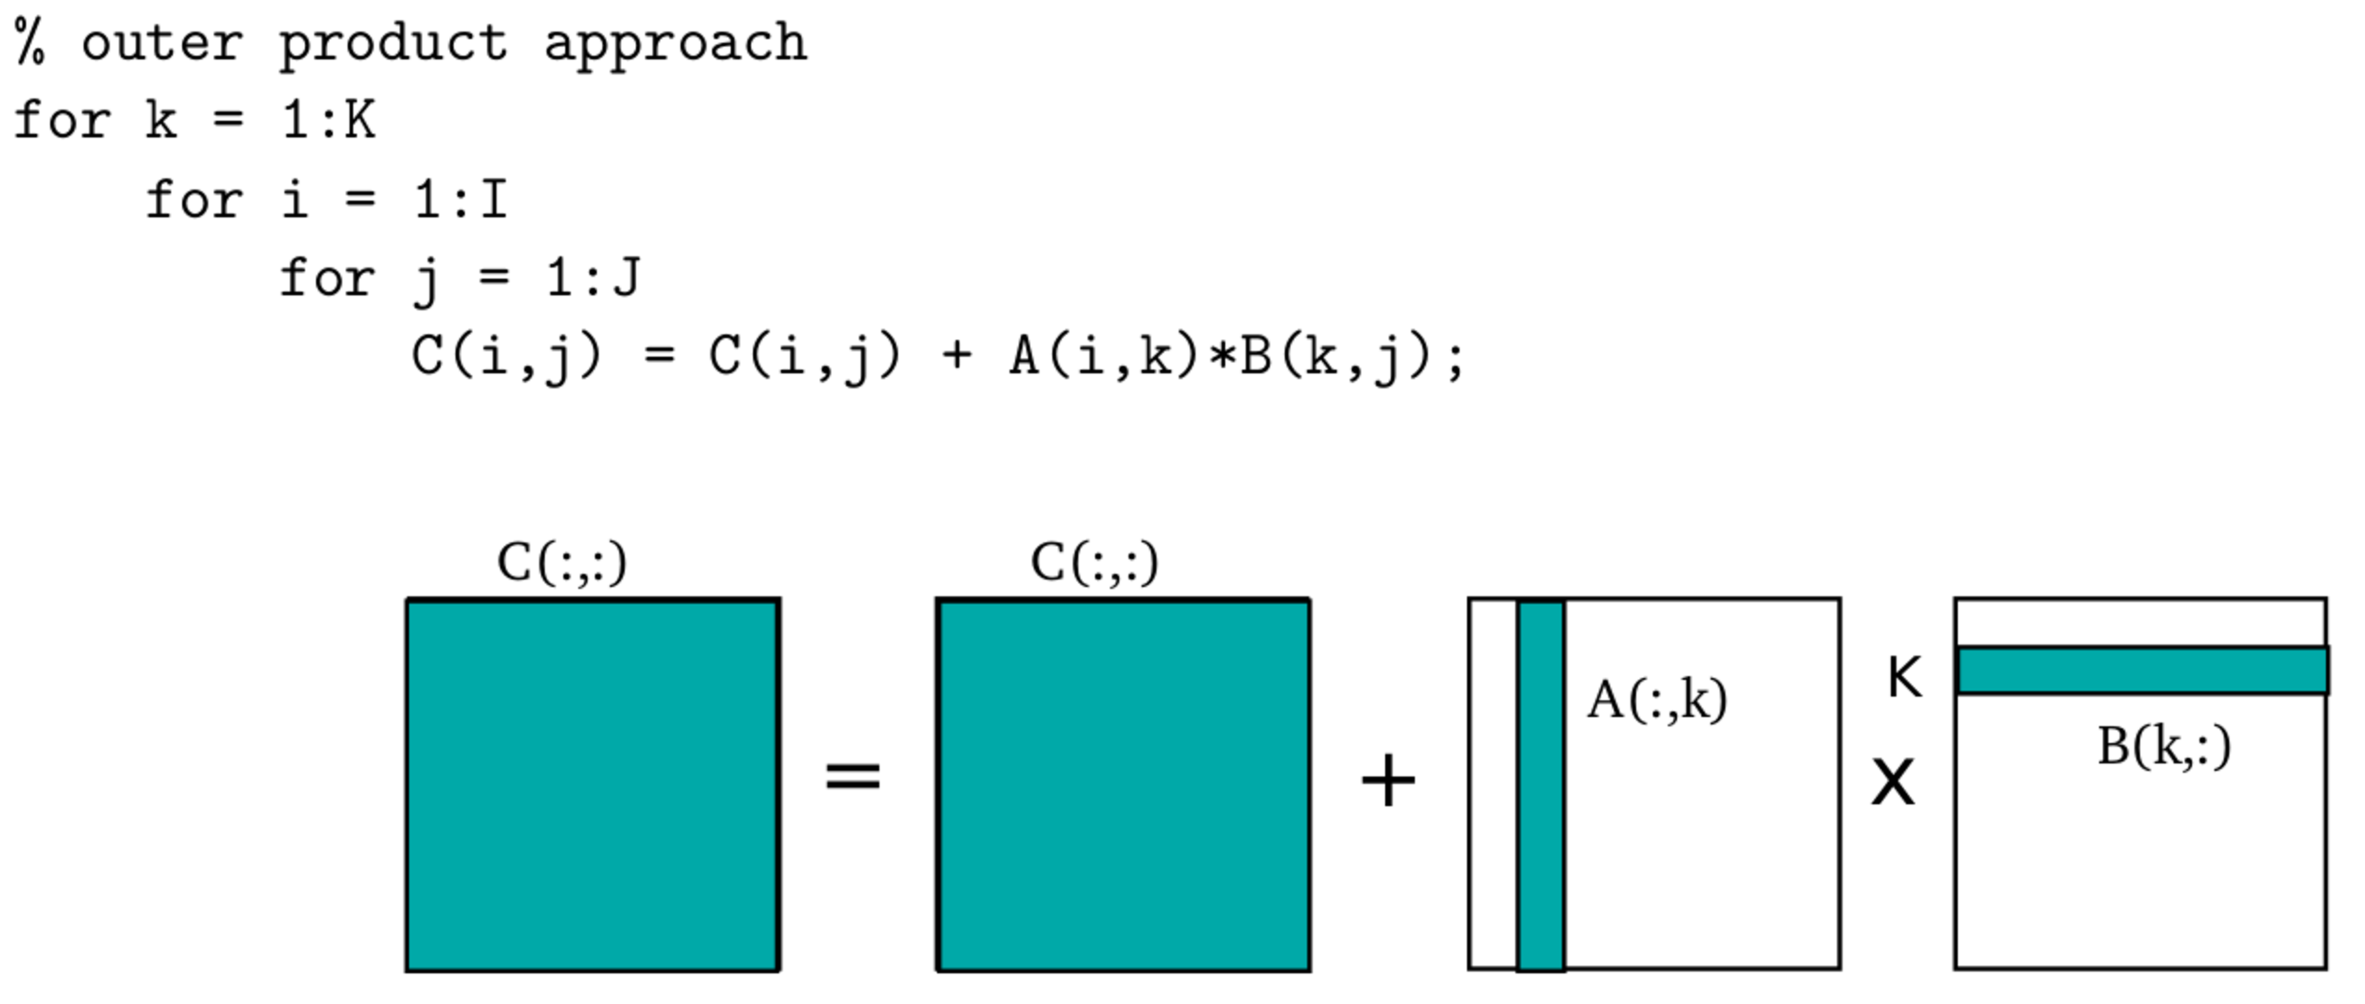

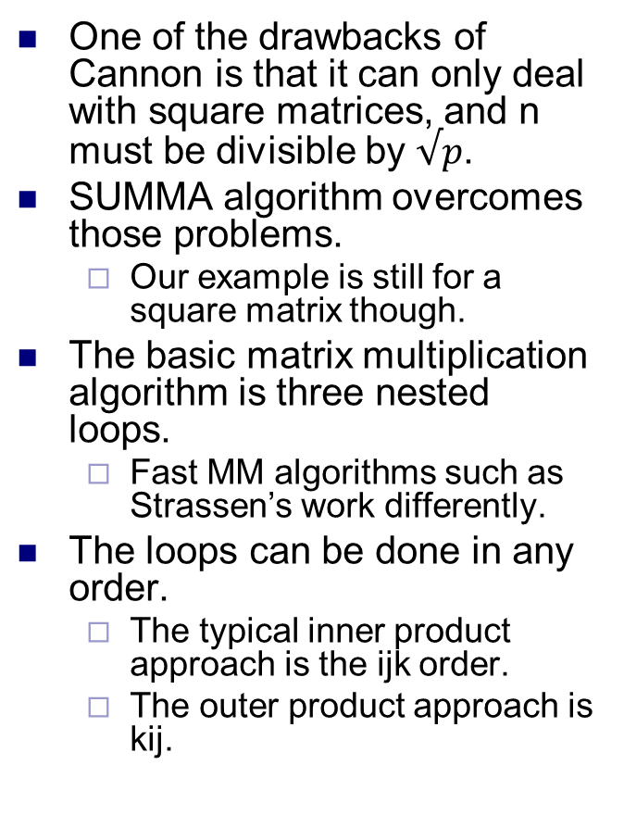
SUMMA multiplication
One of the drawbacks of Cannon is that it can only deal with square matrices, and n must be divisible by $√p$.
SUMMA algorithm overcomes those problems.
Our example is still for a square matrix though.
The basic matrix multiplication algorithm is three nested loops.
Fast MM algorithms such as Strassen’s work differently.
The loops can be done in any order.
The typical inner product approach is the ijk order.
The outer product approach is kij.
Source: https://patterns.eecs.berkeley.edu/?page_id=158

Slide 13
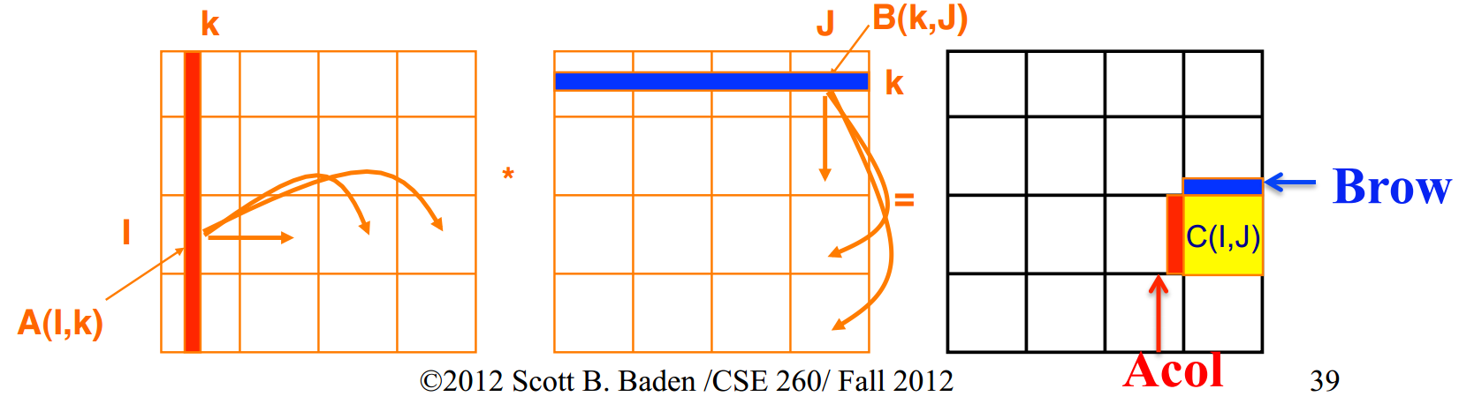
SUMMA multiplication
SUMMA does n outer products.
k’th iteration does outer product of k’th column of A with k’th row of B.
Processors in k’th column broadcast their A block to their rows.
Processors in k’th row broadcast their B block to their columns.
Processor (i,j) computes A_{i,k} B_{k,j} and accumulates it into C_{i,j}.
Matrices don’t need to be square.
Also allows more flexible mapping of processors to blocks.

Slide 14
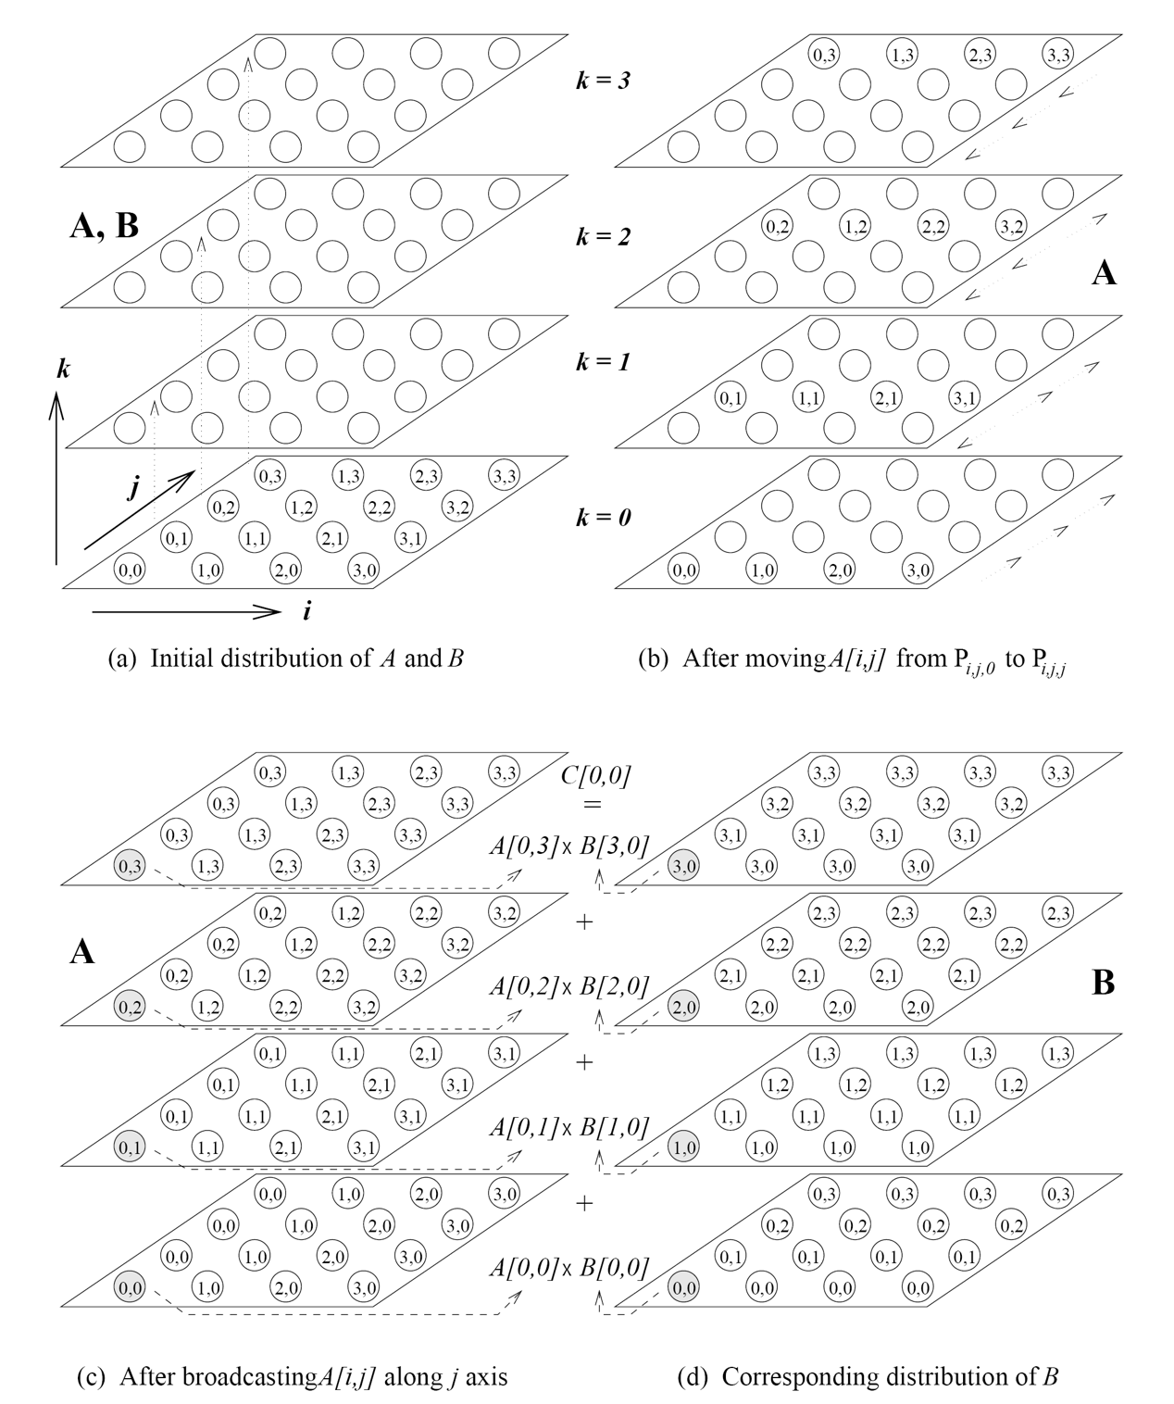
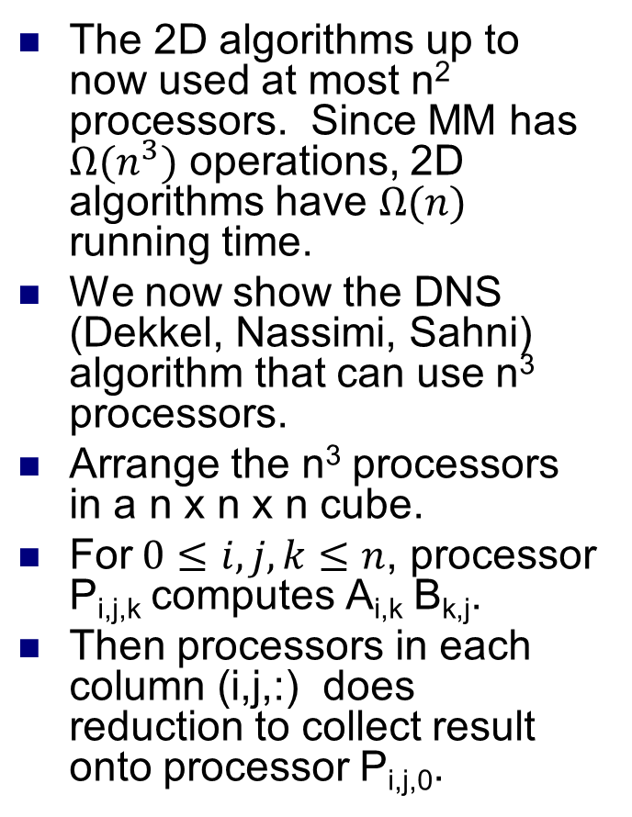
3D matrix multiplication
The 2D algorithms up to now used at most n² processors. Since MM has $Ω(n^{3})$ operations, 2D algorithms have $Ω(n)$ running time.
We now show the DNS (Dekkel, Nassimi, Sahni) algorithm that can use n³ processors.
Arrange the n³ processors in a n x n x n cube.
For$0≤i,j,k≤n$, processor P_{i,j,k} computes A_{i,k} B_{k,j}.
Then processors in each column (i,j,:) does reduction to collect result onto processor P_{i,j,0}.

Slide 15
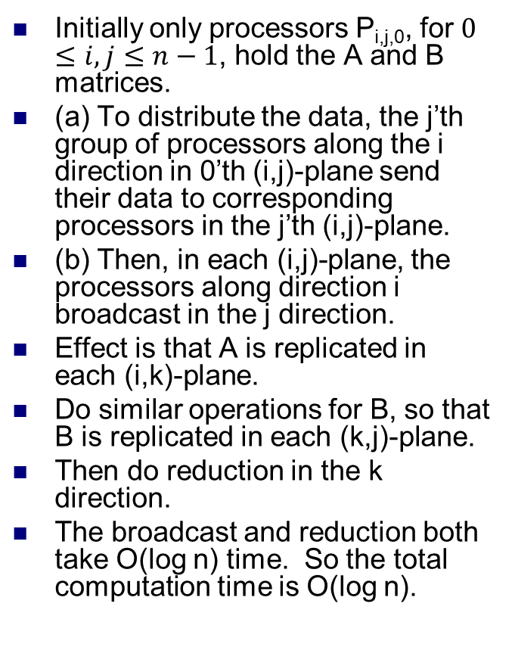
3D matrix multiplication
Initially only processors P_{i,j,0}, for $0 ≤i,j≤n−1$, hold the A and B matrices.
(a) To distribute the data, the j’th group of processors along the i direction in 0’th (i,j)-plane send their data to corresponding processors in the j’th (i,j)-plane.
(b) Then, in each (i,j)-plane, the processors along direction i broadcast in the j direction.
Effect is that A is replicated in each (i,k)-plane.
Do similar operations for B, so that B is replicated in each (k,j)-plane.
Then do reduction in the k direction.
The broadcast and reduction both take O(log n) time. So the total computation time is O(log n).

Slide 16
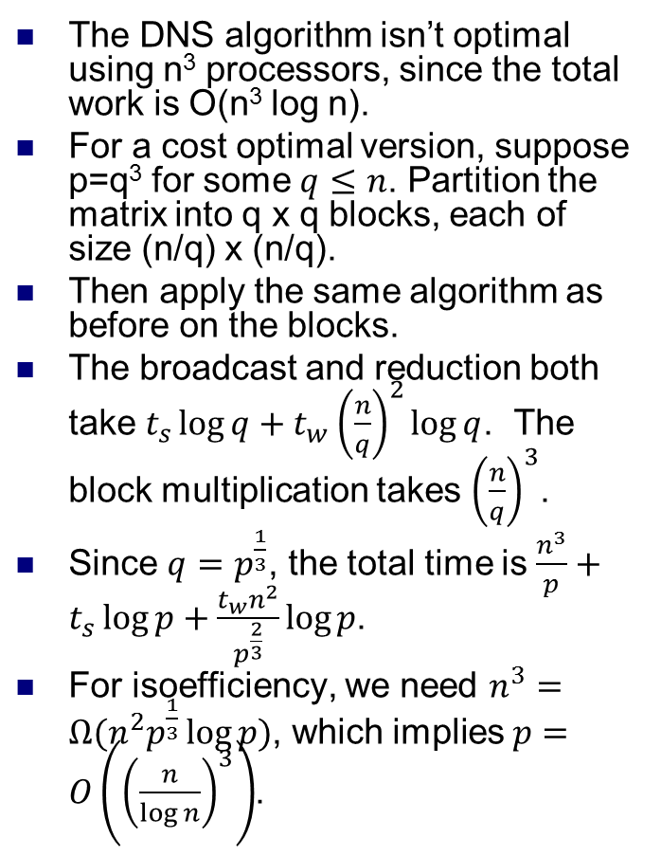
3D matrix multiplication
The DNS algorithm isn’t optimal using n³ processors, since the total work is O(n³ log n).
For a cost optimal version, suppose p=q³ for some $q≤n$. Partition the matrix into q x q blocks, each of size (n/q) x (n/q).
Then apply the same algorithm as before on the blocks.
The broadcast and reduction both take $t_{s}\log{q}+t_{w}{\left(\frac{n}{q}\right)}^{2}\log{q}$. The block multiplication takes ${\left(\frac{n}{q}\right)}^{3}$.
Since $q=p^{\frac{1}{3}}$, the total time is $\frac{n^{3}}{p}+t_{s}\log{p+\frac{t_{w}n^{2}}{p^{\frac{2}{3}}}\log{p}}$.
For isoefficiency, we need $n^{3}=Ω(n^{2}p^{\frac{1}{3}}\log{p})$, which implies $p=O\left({\left(\frac{n}{\log{n}}\right)}^{3}\right)$.

Slide 17
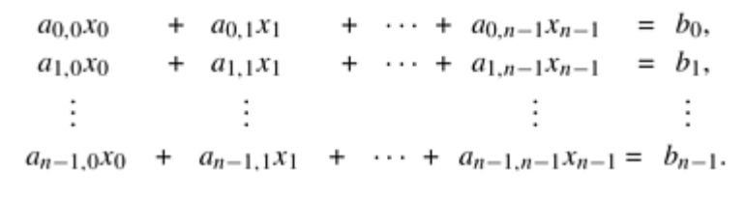
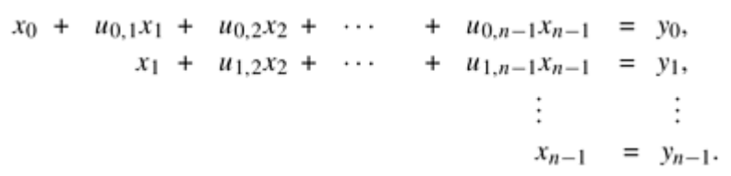
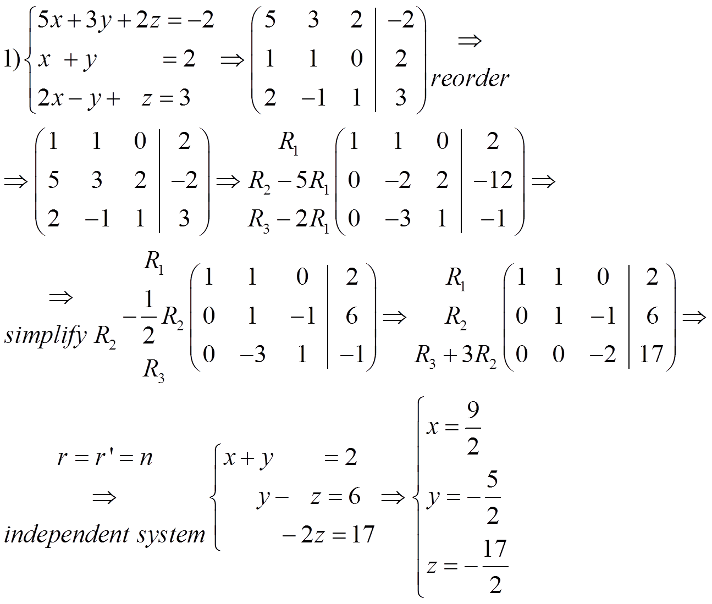
Solving linear systems
Given a system of n linear equations, we can reduce it to triangular form using Gaussian Elimination.
Then the triangular equations can be solved by back substitution.
As we’ll see, Gaussian Elimination takes O(n³) operations, and back substitution takes O(n²) operations. So linear systems can be solved in O(n³) operations.
Given a matrix A, if Ax = b needs to be solved for multiple b vectors, can also use Gaussian Elimination to compute the LU factorization of A, i.e. A = LU, where L is a lower triangular and U is an upper triangular matrix.
Then LUx = b can be solved by first solving Ly = b using backwards substitution, then solving Ux = y using backwards substitution.
Both steps take O(n²) time. So solving Ax = b for each b takes O(n²) instead of O(n³) time.
The initial LU decomposition takes O(n³) time.

Slide 18
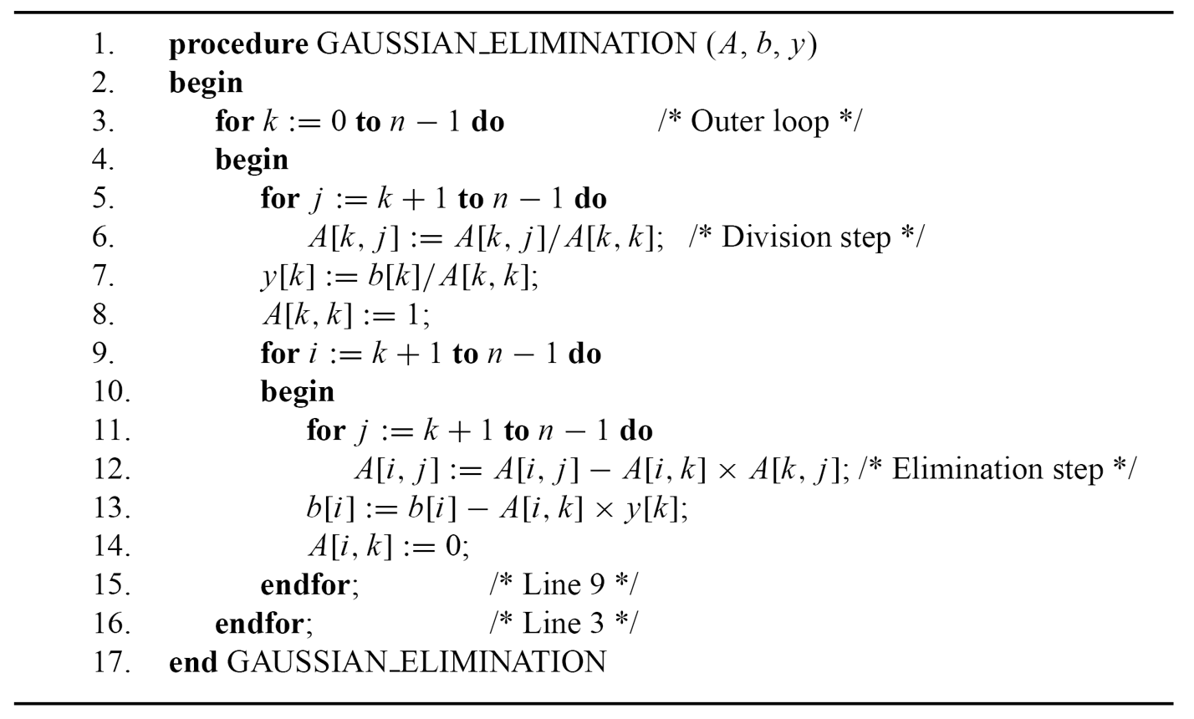
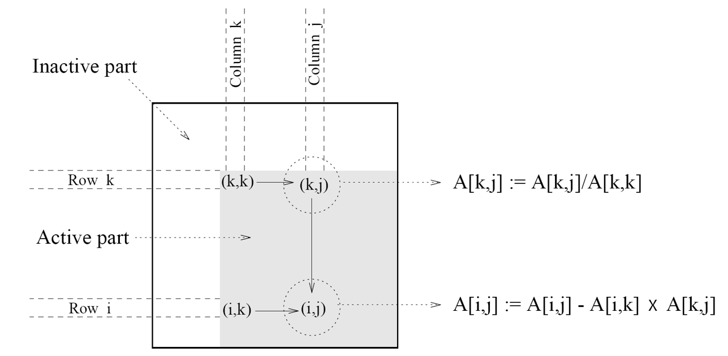
Gaussian Elimination
Three nested loops of size n, so O(n³) time.
Here we assume for simplicity that A[k,k], which we divide by on line 6, is never 0.
We also ignore numerical accuracy issues.
These are addressed using pivoting.
Iteration k of the algorithm uses A[k,k] to eliminate all nonzeros in column k.
If we don’t perform lines 7, 8, 13 and 14, the algorithm produces the LU decomposition of A, with L and U stored in the lower and upper triangular parts of A.

Slide 19
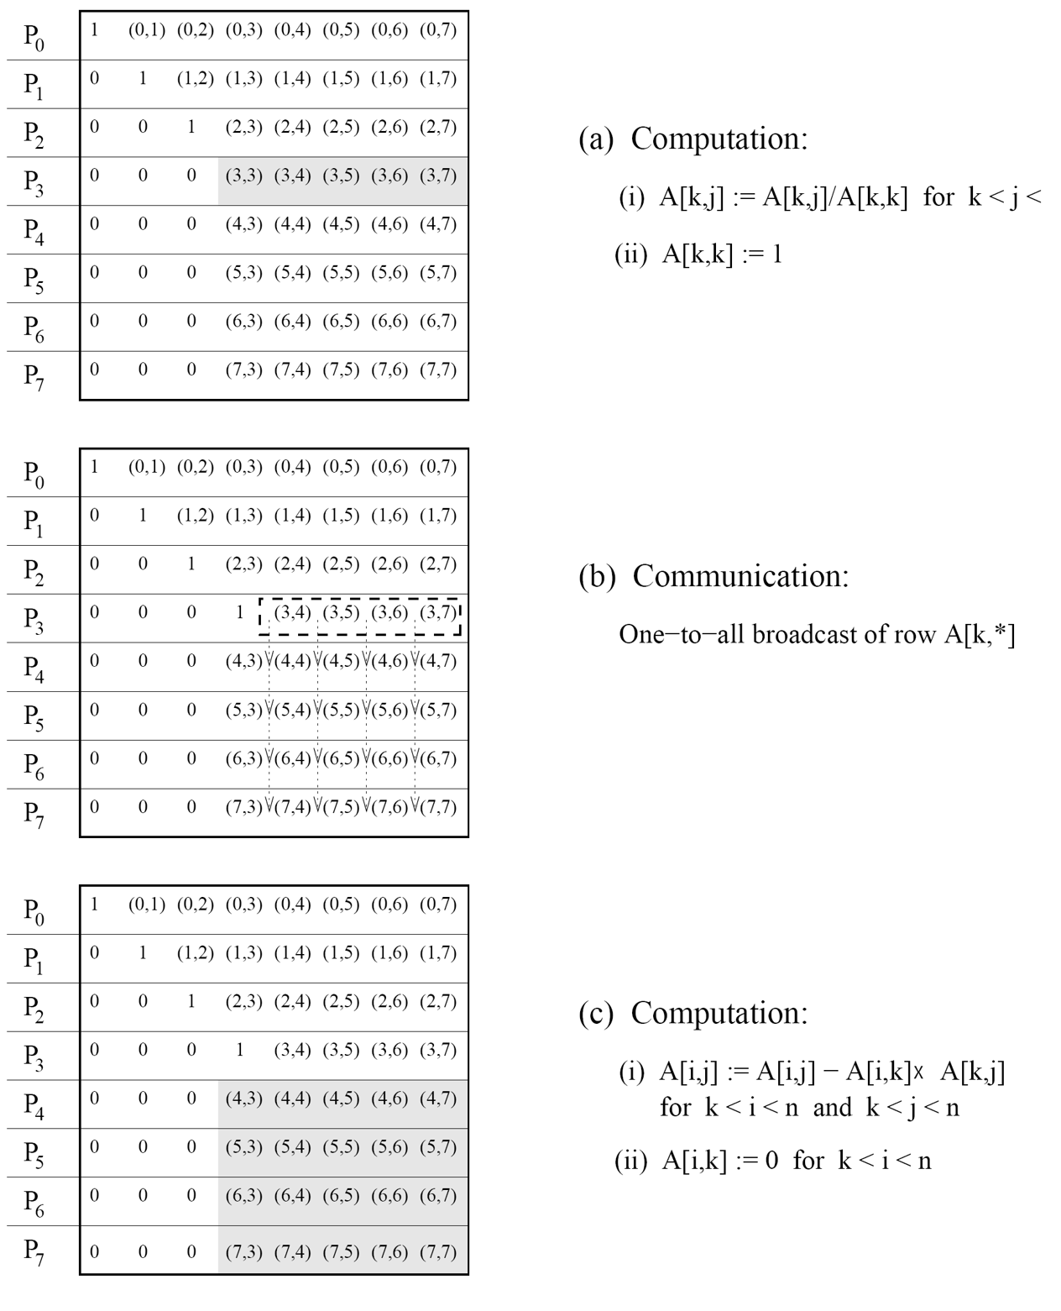
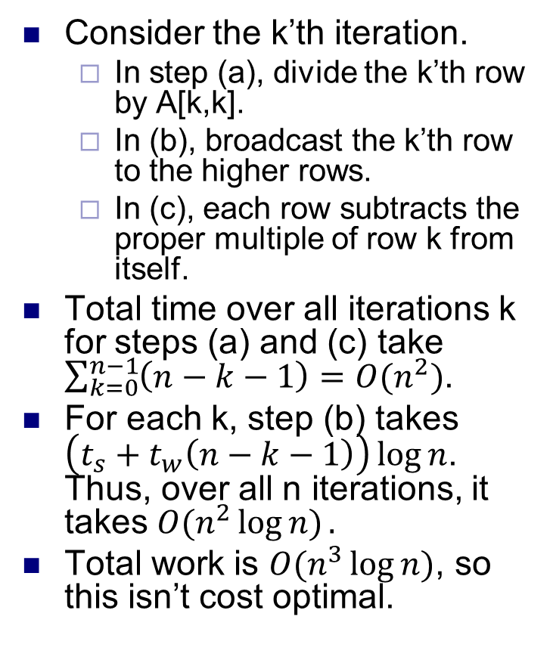
Parallel Gaussian Elimination
Consider the k’th iteration.
In step (a), divide the k’th row by A[k,k].
In (b), broadcast the k’th row to the higher rows.
In (c), each row subtracts the proper multiple of row k from itself.
Total time over all iterations k for steps (a) and (c) take $\sum_{k=0}^{n−1}{\left(n−k−1\right)=O(n^{2})}$.
For each k, step (b) takes $\left(t_{s}+t_{w}\left(n−k−1\right)\right)\log{n}$. Thus, over all n iterations, it takes $O(n^{2}\log{n)}.$
Total work is $O(n^{3}\log{n)}$, so this isn’t cost optimal.

Slide 20
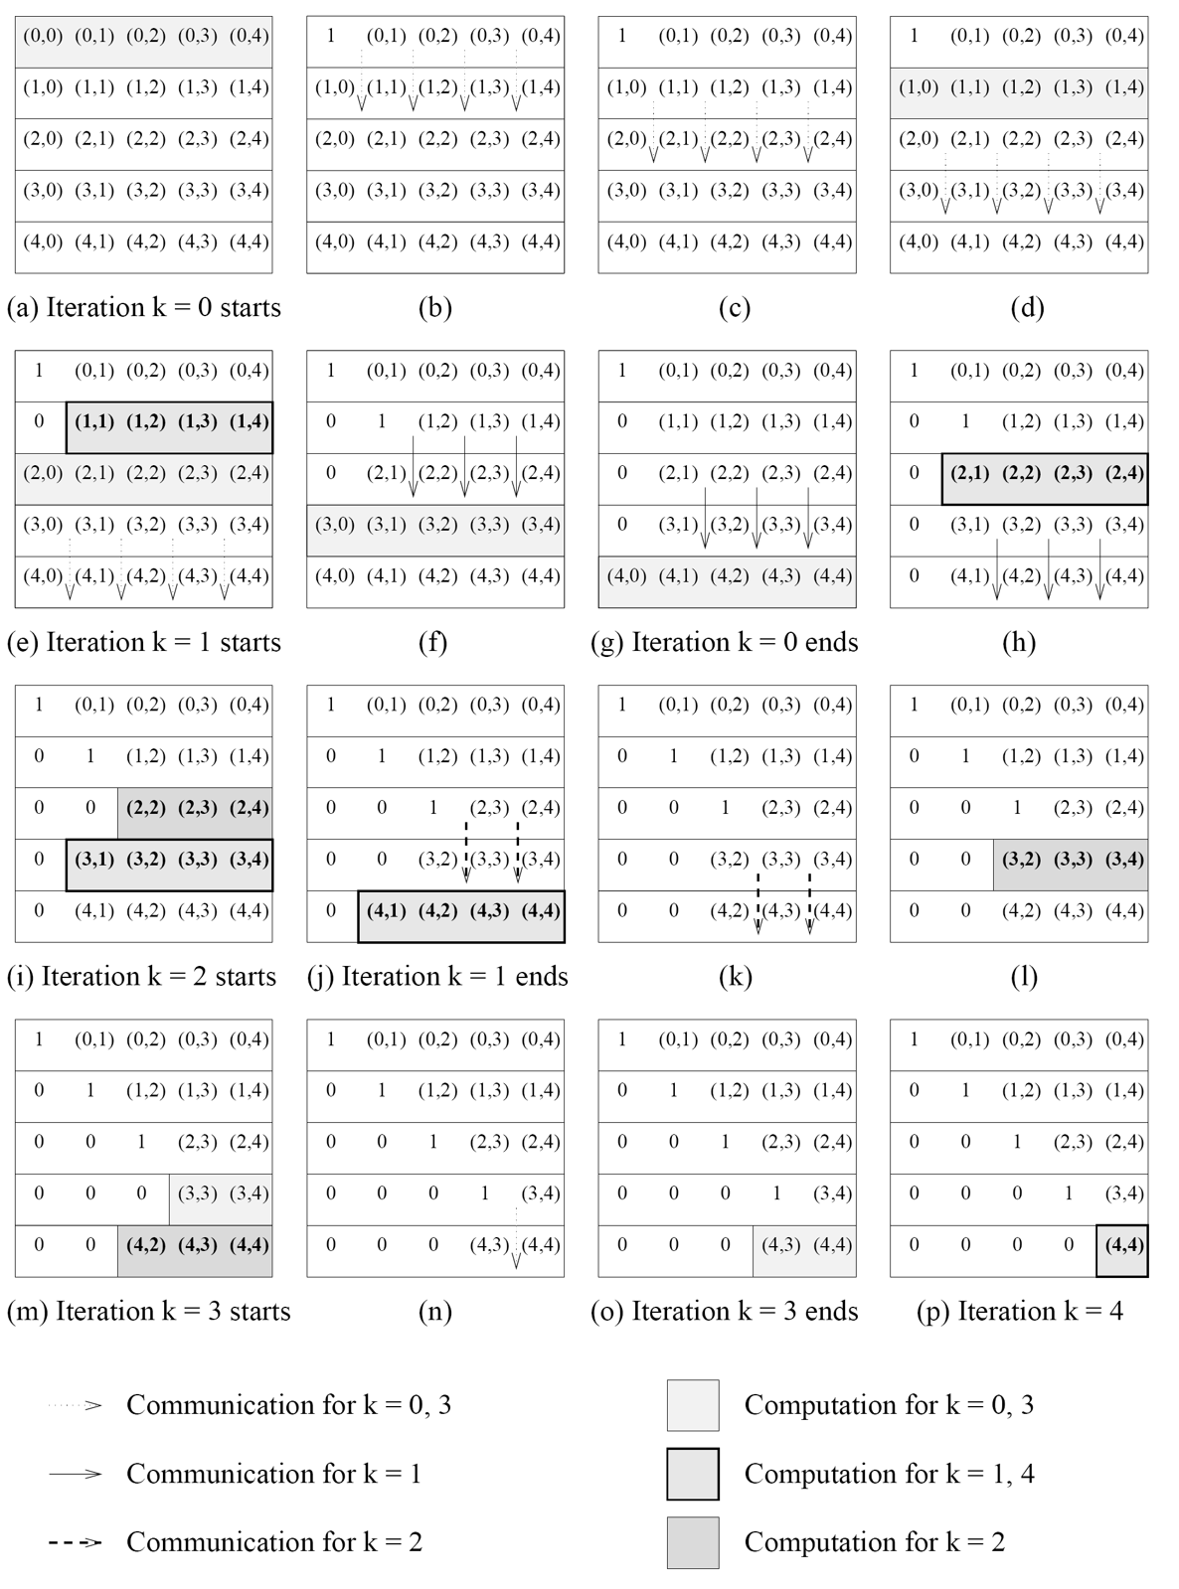
Pipelined Gaussian Elimination
One problem with previous algorithm is that it waited till iteration k was finished (i.e., the entire k’th column has been eliminated using the k’th row) before starting iteration k+1.
We can use a more efficient pipelined algorithm, where each row uses and sends data as quickly as possible.
When a row receives data from the previous row, it sends the data to the next row.
The row eliminates a variable.
Then the row waits for new data from the previous row.
When the first nonzero in the row is the diagonal element, it divides out by this row and sends this to the next row.
Then the row stops.

Slide 21
Pipelined Gaussian Elimination
For each row, call the 3 steps (recv, send, eliminate) a cycle.
A row eliminates a variable every cycle.
The last row receives its last piece of data after n cycles.
So the entire algorithm finishes after O(n) cycles.
Each cycle involves dividing, subtracting or sending O(n) items, so takes O(n) time.
So algorithm takes total O(n²) time.
So total work is O(n³), and the algorithm is work optimal.

Slide 22
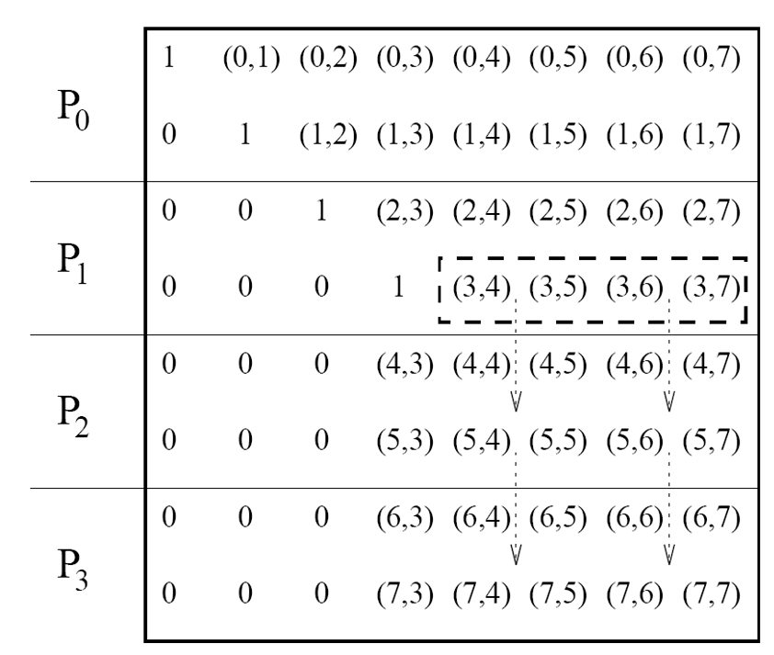
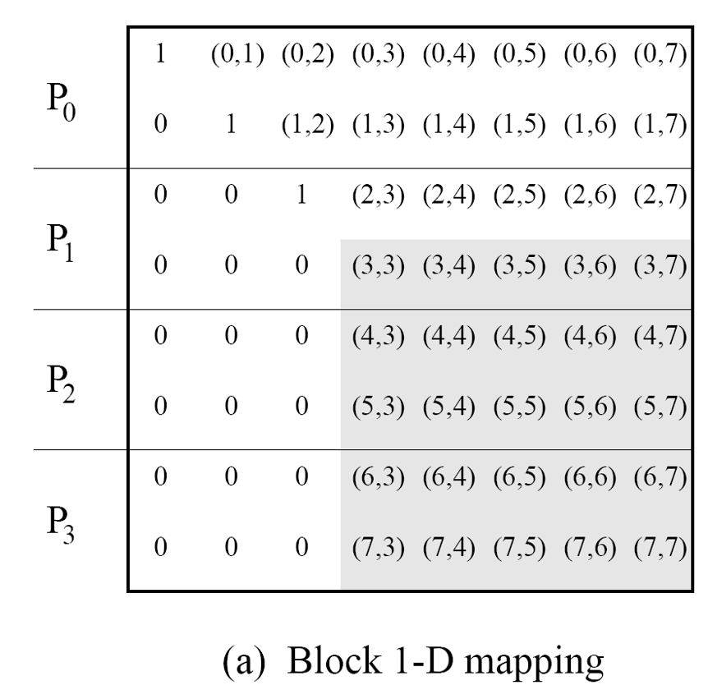
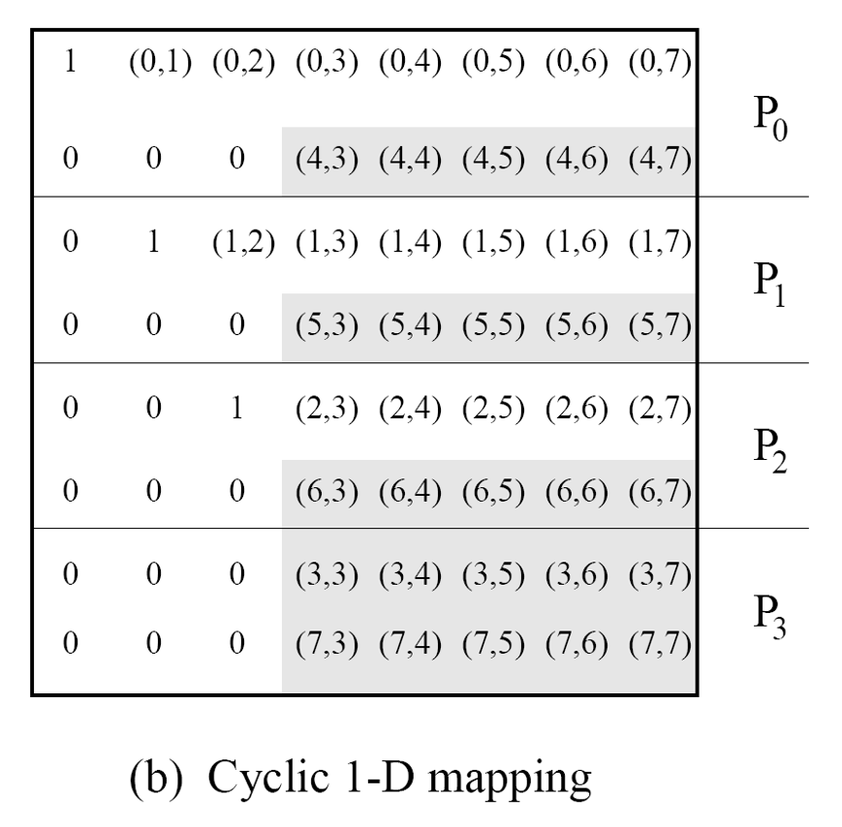
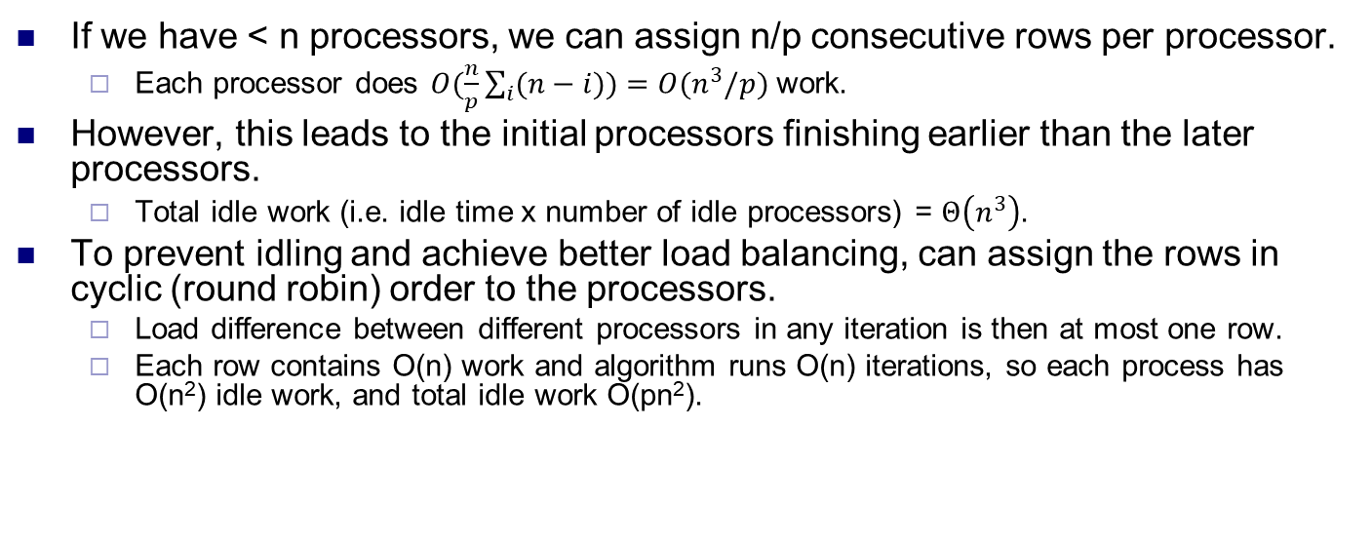
Fewer processors, load balancing
If we have < n processors, we can assign n/p consecutive rows per processor.
Each processor does $O(\frac{n}{p}\sum_{i}{(n−i))=O(n^{3}/p)}$ work.
However, this leads to the initial processors finishing earlier than the later processors.
Total idle work (i.e. idle time x number of idle processors) = $Θ\left(n^{3}\right)$.
To prevent idling and achieve better load balancing, can assign the rows in cyclic (round robin) order to the processors.
Load difference between different processors in any iteration is then at most one row.
Each row contains O(n) work and algorithm runs O(n) iterations, so each process has O(n²) idle work, and total idle work O(pn²).

